Slide 1
Intro to SQL
Megan McCorquodale
VanHAC 2018

Slide 2
Outline
Why?
Setup and installation
Intro to Postgres
Creating Tables
Basic SQL commands
Hands on Examples
Resources

Slide 3
Who is this for?
Beginners!
People who want a refresher on basic SQL
We’re going to be hands on, so thanks in advance for your patience

Slide 4
Why SQL?
One of the more intuitive coding languages
Integrates well with common analysis workflows
“Friends don’t let friends use excel”

Slide 5
Why SQL?
“Friends don’t let friends use excel”
“Friends help friends use excel better”

Slide 6
Why postgresSQL?
Free
Open Source
Lots of documentation
Already a really great intro to postgres for hockey analytics by @draglikepull

Slide 7
What SQL is good for
Data organization
Data Storage
Not a replacement for R, python or spreadsheets but can help you make your data ready for analysis in a reproducible way

Slide 8
Caveat
I like SQL for data cleaning, YMMV
Reproducible
Can easily create new variables and tables
Records how you got there, which is great for troubleshooting
BUT - DATA CLEANING WILL ALWAYS SUCK
Bad data gives bad results, no matter the tool

Slide 9
Let’s set up Postgres

Slide 10
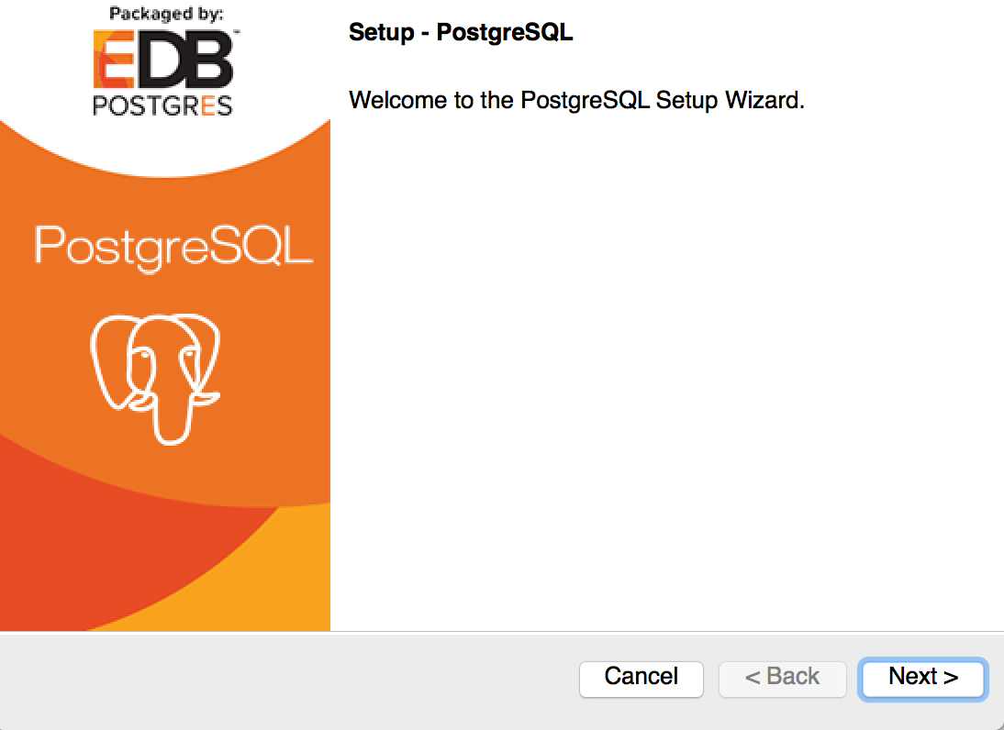
PostgreSQL Setup
Run the installer

Slide 11
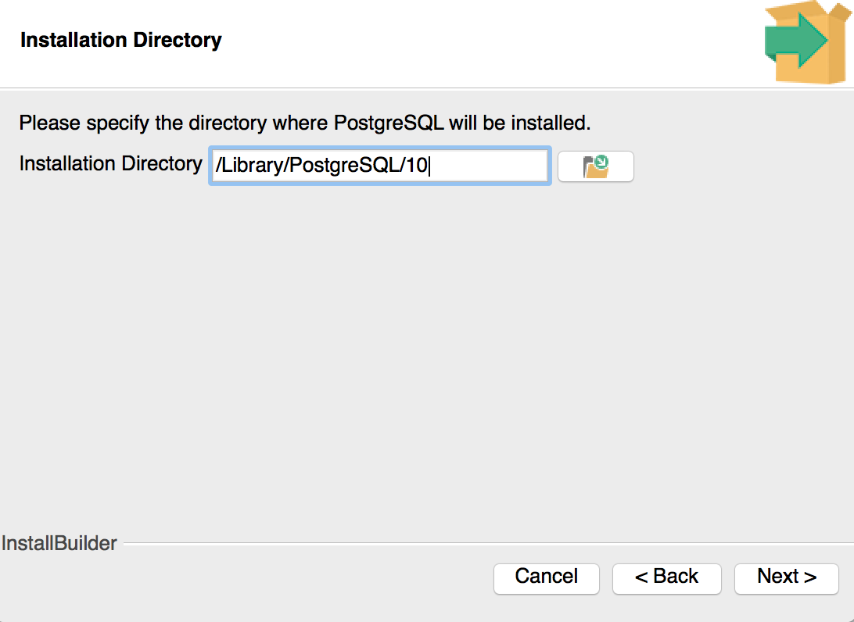
PostgreSQL Setup
Select where you want to save the program

Slide 12
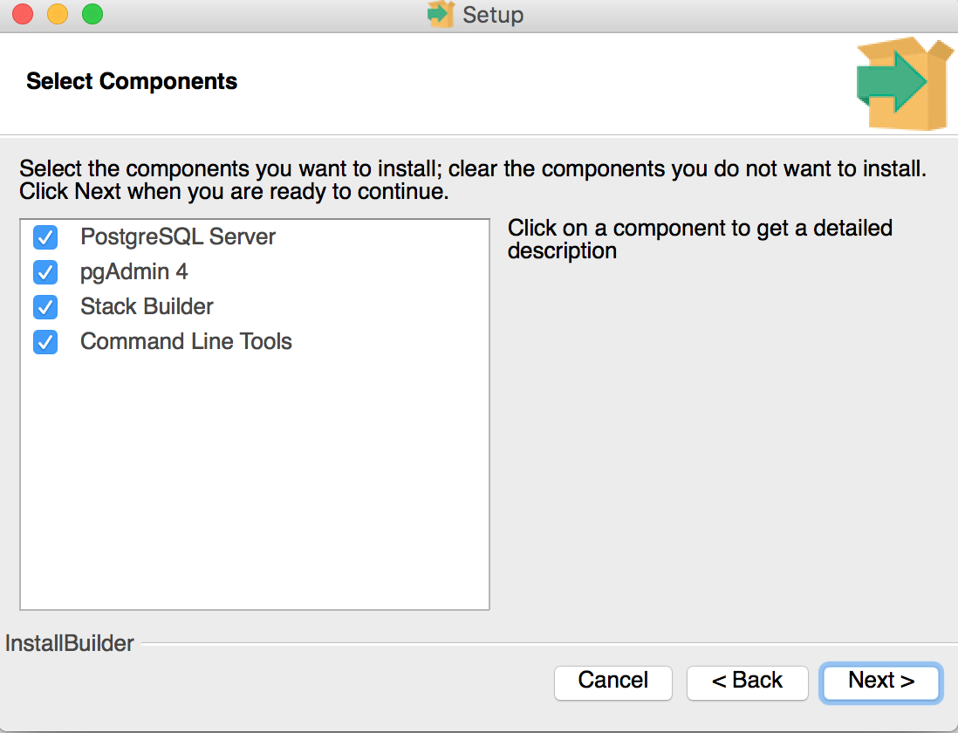
PostgreSQL Setup
Select all for now

Slide 13
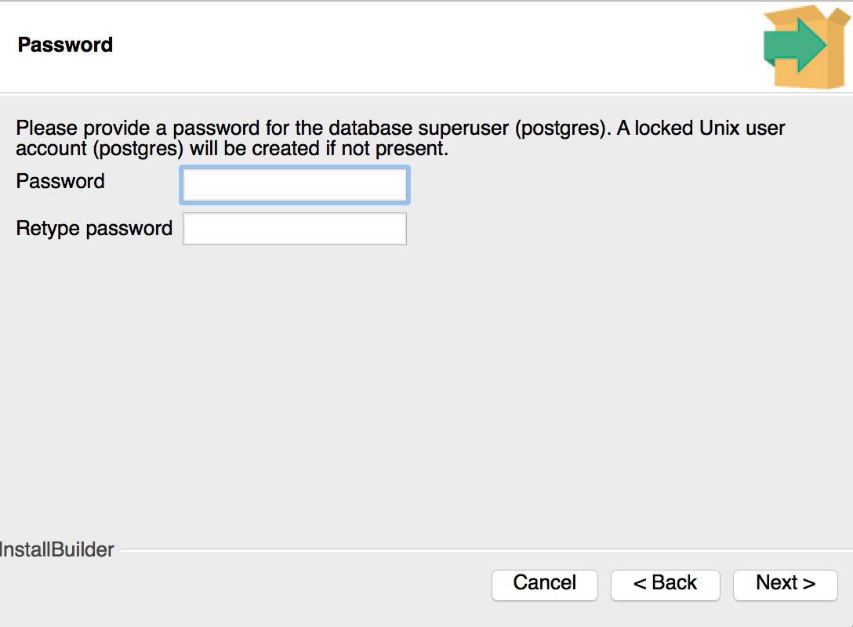
PostgreSQL Setup
Create a password to access your database - REMEMBER THIS!

Slide 14
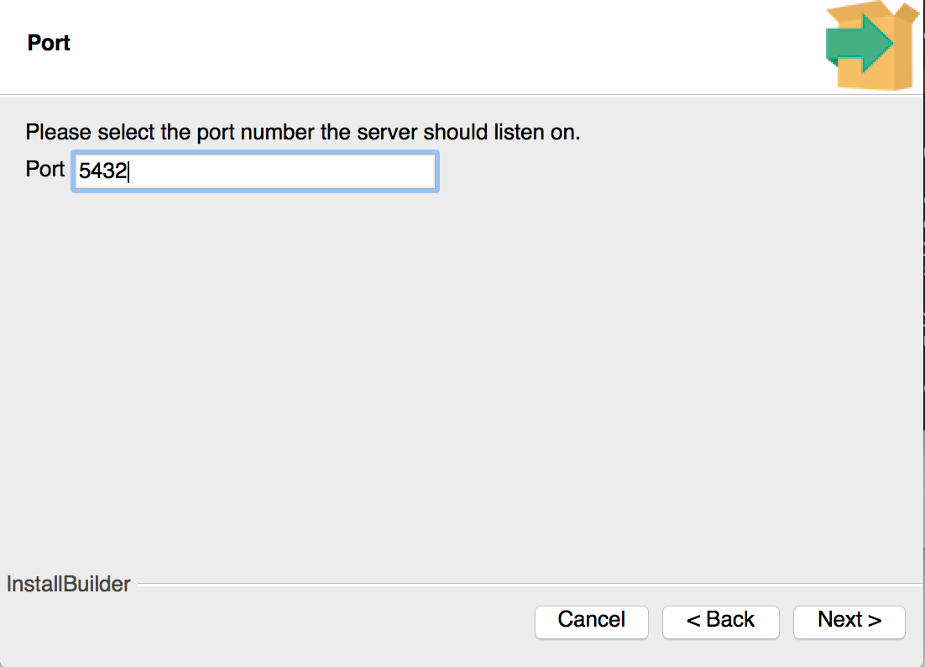
PostgreSQL Setup
Select port - the default should work for everyone

Slide 15

PostgreSQL Setup
TBH I don’t know what this does? I said allow.

Slide 16
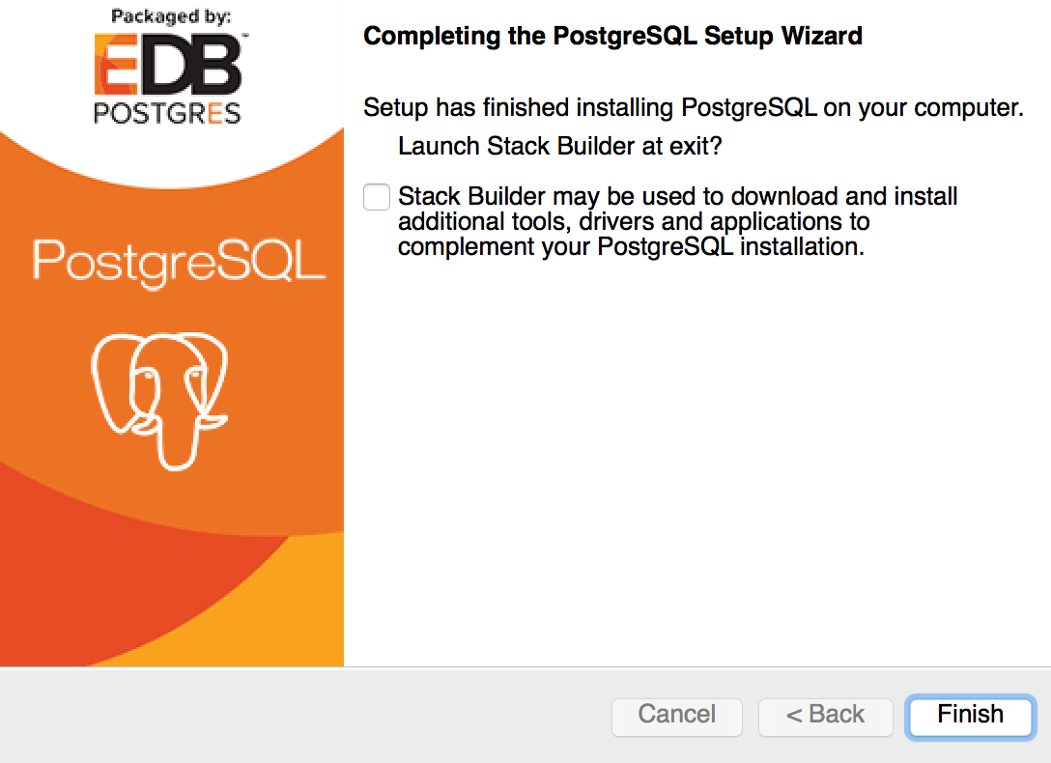
PostgreSQL Setup
Yay we’ve installed PostgresSQL! Click Finish

Slide 17
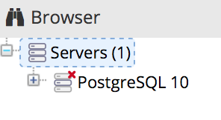
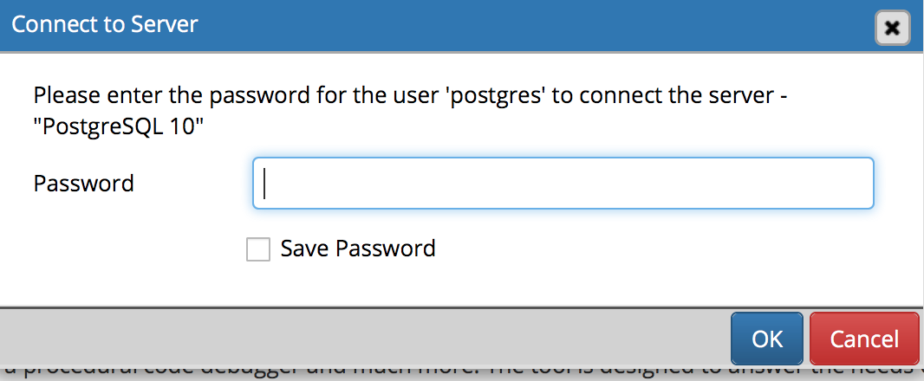
PostgreSQL Setup
Open pgAdmin 4
Click on the “PostgresSQL 10” database
Enter the password you created

Slide 18
We’re ready to code!

Slide 19
Data
Get the dataset here:
https://hockey-graphs.com/events/vanhac18/
You want:
hockey_abstract_whockey_cleaned.csv
Vanhac_SQL_code.txt
Thanks to @robvollmanNHL for supplying the dataset

Slide 20
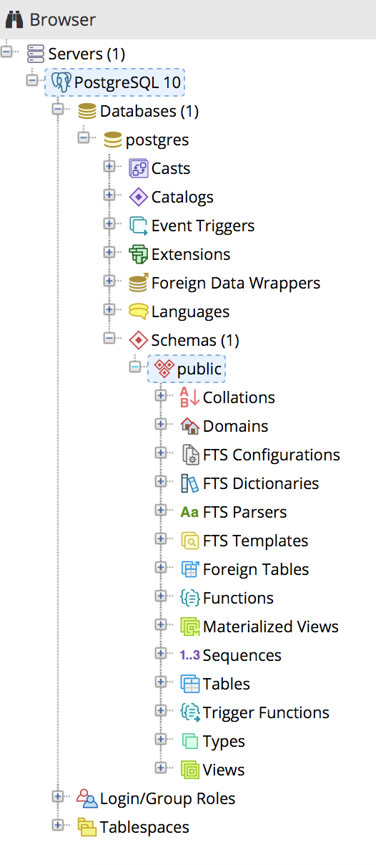
Postgres Basics
Database: collection of data organized so you can easily access, update and manage it
Schema: collection of database objects (here: tables) associated with one database
Table: file with rows and columns of data
Notes:
Tables are basically excel files
Schemas are basically folders to organize within the database (per project is a good idea)

Slide 21
Creating a Table
Declare variable names and data types
Two main ways to get data into your database:
Write data in manually
Upload a csv/excel file
* Naming things is hard.

Slide 22
Data Types for variables
VARCHAR(n) - any combination of letters and numbers
INTEGER(n) - numbers without decimals
REAL(n) or FLOAT(n) - numbers with decimals
BOOLEAN - true or false
TIMESTAMPZ - stores date and time
** (n) here specifies the maximum number of characters in your variable. You can not specify a length and it will adjust to the size of your data. If you do specify an (n) and go over, your data will be truncated. **

Slide 23
Before we start
Some weird things about postgres:
Variable names need “” around them
Variable character values need ‘’ around them
When referring to a table, you need to specify the schema
Case sensitive (unlike other SQL)

Slide 24
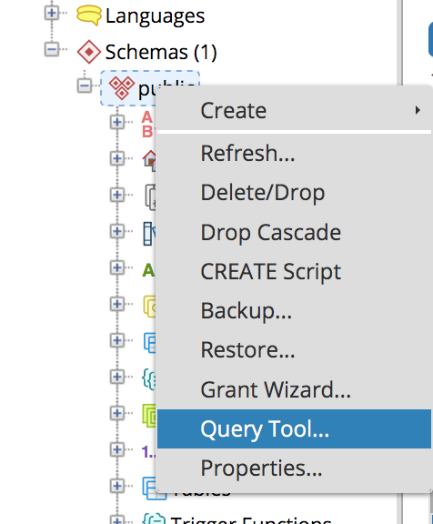
Time to code
Right click on the public schema
Select the Query Tool
This is where we will write our queries

Slide 25
Creating our first table
First we have to declare the variable names and types
CREATE TABLE public."olympic_results" ( "Year" integer, "Country" varchar, "Wins" integer, "Losses" integer, "Medal" varchar )

Slide 26
Creating our first table
Then write data values manually into the columns
INSERT INTO public."olympic_results" ("Year", "Country", "Wins", "Losses", "Medal") VALUES (2018, 'Canada', 4, 1, 'Silver'), (2018, 'USA', 4, 1, 'Gold'), (2018, 'Finland', 3, 3, 'Bronze'), (2014, 'Canada', 5, 0, 'Gold'), (2014, 'USA', 3, 2, 'Silver'), (2014, 'Switzerland', 2, 4, 'Bronze')

Slide 27
Importing data from a file
CREATE TABLE public."womens_hockey" ( "season" varchar, "league" varchar, "trans" real, "yrAdj" real, "firstname" varchar, "lastname" varchar, "pos" varchar, "team" varchar, "GP" integer, "G" integer, "A" integer, "PTS" integer, "GC" real, "WCe" real, "PIM" integer, ... )
Again we have to declare our variables and data types

Slide 28
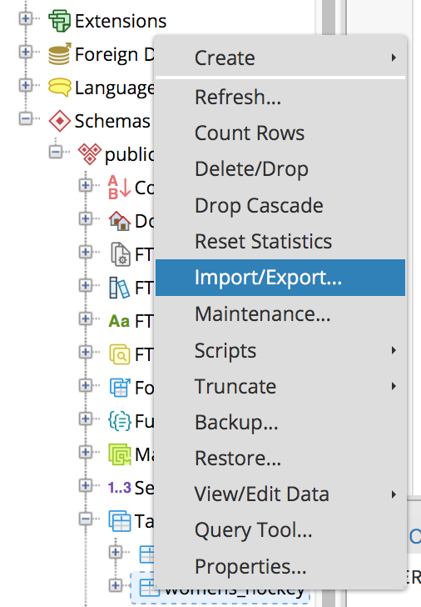
Importing data from a file
Right click the ‘public’ schema
Select ‘Import/Export..’

Slide 29
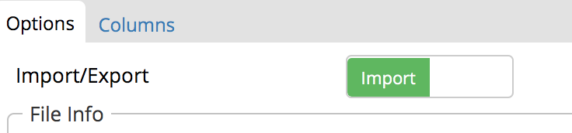
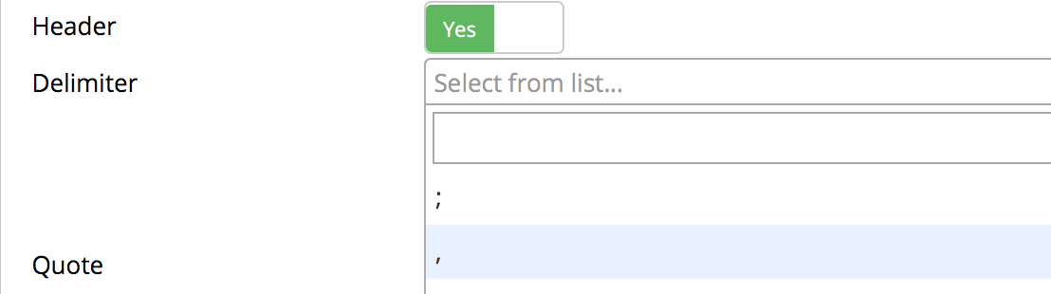
Importing data from a file
Select Import
Select Header
Select , as the delimiter (for csv files)
Tab to Columns and check the selected columns to import

Slide 30
SELECT
The most basic command - we specify which columns to display
SELECT * selects all columns in a table
SELECT * FROM public."womens_hockey"
SELECT "Country" , "Year" , "Medal" FROM public."olympic_results"

Slide 31
SELECT DISTINCT
Select Distinct only pulls in unique values
Useful to check for duplicates
Multiple columns at once - all unique combinations that appear in your data
SELECT DISTINCT "pos" FROM public."womens_hockey"
SELECT DISTINCT "league" , "season" FROM public."womens_hockey"

Slide 32
WHERE
Basic filtering
No aggregate functions in where statements
SELECT "season" , "league" , "firstname" , "lastname" , "pos" , "team" , "GP" , "G" , "A" , "PTS" , "PIM" , "plusminus" , "shots" FROM public."womens_hockey" WHERE "GP" >= 5
SELECT "Country" , "Year" , "Medal" FROM public."olympic_results" WHERE "Country" = 'Canada'

Slide 33
Logical Operators
AND - both conditions must be true
OR - at least one of the conditions is true
IN - in a given list of values
Can chain together for more complex filters. Be careful, use brackets
SELECT * FROM public."womens_hockey" WHERE "league" = 'NWHL' AND "season"= '2015'
SELECT * FROM public."womens_hockey" WHERE "league" = 'NWHL' OR "league"= 'CWHL'
SELECT * FROM public."womens_hockey" WHERE "pos" in ('F', 'RW', 'LW', 'C')
SELECT * FROM public."womens_hockey" WHERE "pos" != 'G'

Slide 34
CREATING AND DELETING TABLES
SELECT …. INTO schema.”table_name” FROM …
Can only select into a table that does not exist
DELETE table - be careful!
SELECT "season" , "league" , "firstname" , "lastname" , "firstname" ||"_"|| "lastname" as "fullname" , "pos" , "team" , "GP" , "G" , "A" , "PTS" , "PIM" , "plusminus" , "shots" INTO public."whockey" FROM public."womens_hockey"

Slide 35
ORDER BY
SELECT "fullname" , "pos" , "league" , "team" , "GP" , "G" , "A" , "PIM" FROM public."whockey" ORDER BY "PTS" desc
Pretty much the sort command from excel
DESC ⬇️
ACS ⬆️
SELECT "fullname" , "pos" , "league" , "team" , "GP" , "G" , "A" , "PIM" FROM public."whockey" ORDER BY "PTS" asc

Slide 36
LIMIT
Limit the amount of data in your results
Good to see a sample of your data
select "season" , "fullname" , "team" , "PTS" from public."whockey" order by "PTS" desc limit 100
SELECT "season" , "league" , "team" , "fullname" , "plusminus" FROM public."whockey" ORDER BY "plusminus" asc LIMIT 100

Slide 37
COUNTS
Super useful for data exploration
Count(*) counts total number of rows
Count(variable) counts the number of rows with data in them
SELECT count("fullname") as "count_players" FROM public."whockey"
SELECT count(*) as "count_total" , count("pos") as "count_positions" FROM public."whockey"

Slide 38
COUNT DISTINCT
Count(distinct variable) counts the unique values of the field
SELECT COUNT(distinct "fullname") FROM public."whockey"
SELECT COUNT(*) FROM (SELECT distinct "fullname" , "team" FROM public."whockey") AS "NEW_TABLE

Slide 39
GROUP BY
SELECT "league" , COUNT(distinct "team") as "count_teams" FROM public."whockey" GROUP BY "league"
Can group by values in a category variable
Need to include all non-aggregated fields in the group by statement
SELECT "team" , "league" , "season" , COUNT(distinct "fullname") as "count_players" FROM public."hockey" GROUP BY "team", "league", "season" ORDER BY "team", "league", "season"

Slide 40
MIN AND MAX
Calculates the minimum or maximum value
If across more than one group, need a group by statement
SELECT min("plusminus") , max("plusminus") FROM public."whockey"
SELECT "league" , min("plusminus") , max("plusminus") FROM public."whockey" GROUP BY "league"

Slide 41
SUM
Adds all values of the column together
Can be used with a GROUP BY statement to get totals within groups
SELECT SUM("G") as "total_goals" FROM public."whockey"
SELECT "fullname" , "team" , SUM("G") FROM public."whockey" GROUP BY "fullname", "team" ORDER BY SUM("G") desc

Slide 42
Creating new variables
Create new variables using mathematical operators
Name the new variable with as “variable name”
Use CAST to change variable types
SELECT "fullname" , "team" , CAST(SUM("G") as FLOAT)/SUM("GP") as "Goals per Game Ave" FROM public."whockey" GROUP BY "fullname", "team" ORDER BY SUM("G") desc

Slide 43
STRING FUNCTIONS
Built in functions to handle string or character variables
Can concatenate, subset etc
Many more - google and stackoverflow are good resources
SELECT "firstname"||'_'||"lastname"||'_'||"season" as "player_year" FROM public."whockey"
SELECT DISTINCT substring("team" from 1 for 2) FROM public."whockey"

Slide 44
LIKE
SELECT * FROM public."whockey" WHERE "firstname" LIKE 'Meg%'
This is my favourite
Can use to match all or part of a string
‘%blah’ - ends in ‘blah’
‘%blah%’ - has ‘blah’ somewhere
‘blah%’ - starts with ‘blah’
SELECT count(distinct "lastname") FROM public."whockey" WHERE "lastname" LIKE 'Mac%'
SELECT count(distinct "fullname") FROM public."whockey" WHERE "lastname" LIKE '%e'
SELECT count(distinct "fullname") FROM public."whockey" WHERE "lastname" LIKE '%Mac%'

Slide 45
Case Statements
SELECT DISTINCT "team" , "season" , "firstname" , case when "G" >= 10 then 1 else 0 end as "over_10_goals_flag" FROM public."whockey"
Useful in creating new variables
Useful way to make flags 🏳️
SELECT "team" , "season" , "league" , "GP" , case when "GP" > 30 then 'lots' when "GP" between 20 and 30 then 'some' else 'a few' end as "game_counts" FROM public."womens_hockey"

Slide 46
UNIONS
Two or more data sets with the same columns
Stack them on top of each other into one big table
SELECT * FROM public."whockey_2014" UNION SELECT * FROM public."whockey_2015"

Slide 47
JOINS
Combine data from multiple tables
Specify and ON condition
Alias the two tables
Two tables per On condition, can have multiple per query
SELECT a."fullname" , a."team" , a."G" as "2014_goals" , b."G" as "2015_goals" FROM public."whockey_2015" a JOIN public."whockey_2014" b ON a."fullname" = b."fullname" AND a."team" = b."team"

Slide 48
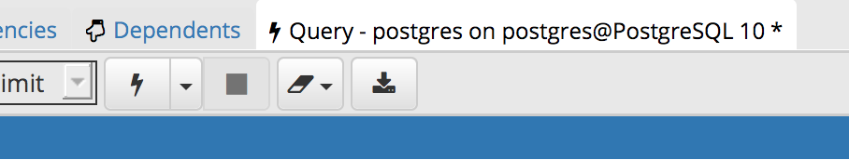
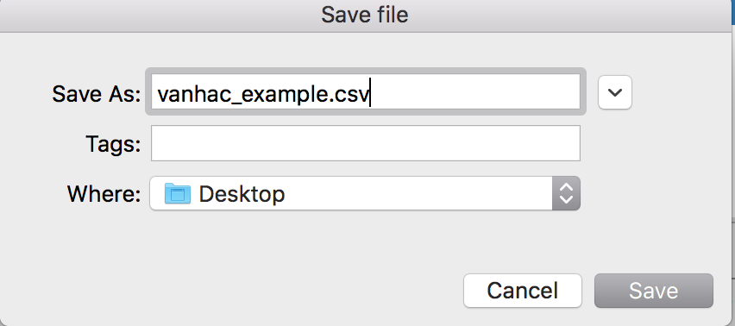
EXPORTING DATA TO CSV
Click on the handy “export to csv” button
Name your file and specify where to save it
Now you have a csv of your new data set you can use in excel/R/Python/whatever

Slide 49
Uninstalling postgreSQL
Windows: basic uninstall in programs
Mac: in terminal:
> open /Library/PostgreSQL/10/uninstall-postgresql.app/

Slide 50
Resources
@draglikepull’s tutorial: https://mapleleafsnation.com/2017/09/08/an-introduction-to-sql-using-hockey-stats/
SQL/postgreSQL resources:
Offical docs: https://www.postgresql.org/docs/8.4/static/index.html
W3Schools: https://www.w3schools.com/sql/
Stackoverflow: https://stackoverflow.com/
Ask me! @datawitch on twitter

Slide 51

QUESTIONS?

Slide 52
Thank you!
https://github.com/datamegan/VanHac_2018

